Slide 1

28/04/2024 Computer Science And System Engineering
WELCOME
Smart Receipt Management &
Extraction
Supervise by honorable Nivede Issur
CST3990 – Undergraduate Individual Project

Slide 2
01/02/2025 WWW.CONSULTING-CENTR.COM
TABLE OF CONTENTS
1.Background
2.Research
3.Methode / implementation
4.Problem encounter
5.Testing
6.Evaluation
7.Conclusion

Slide 3

01/02/2025 WWW.CONSULTING-CENTR.COM
1.BACKGROUND
Corporate strategy consulting plays a pivotal role in helping organizations navigate complex business environments, identify growth opportunities, and achieve their long-term objectives. This comprehensive guide provides an in-depth exploration of corporate strategy consulting, covering key concepts, methodologies, and best practices. From analyzing competitive advantage to implementing strategic initiatives, this document serves as a valuable resource for executives, managers, and consultants involved in shaping the future direction of their organizations.

Slide 4








2.Literature Review
Object detection
Text Extraction
Mobile Development
YOLO Image detection v5
VS
Azure Computer vision API
Google Cloud Vision API
Tesseract OCR
Custom Convolutional Neural Network
Flutter
React Native
(Wu, 2018).
01/02/2025 WWW.CONSULTING-CENTR.COM

Slide 5
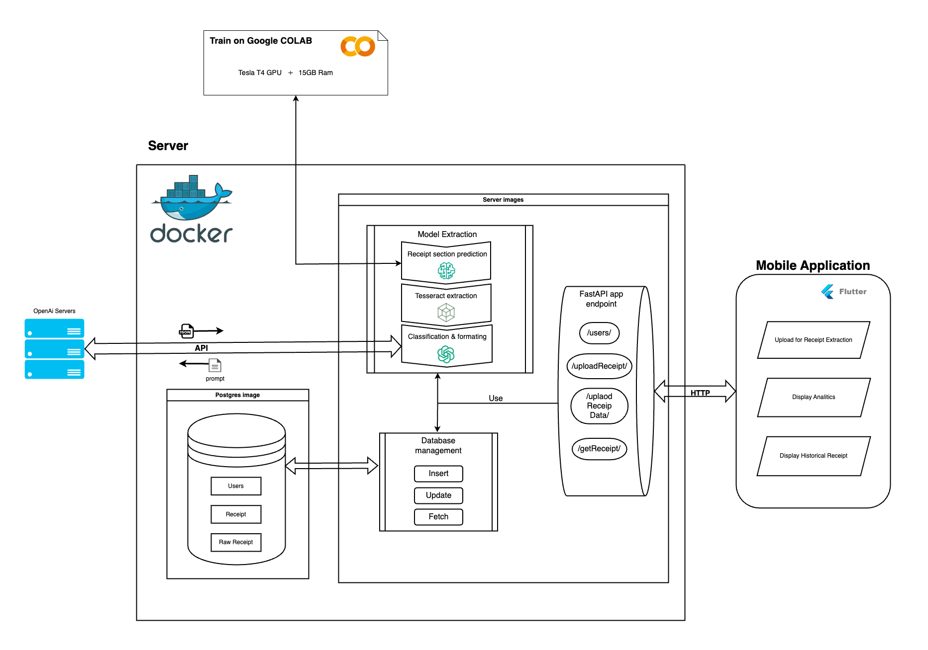
3. Implementation
3Situation Analysis: Consultants conduct comprehensive analyses of internal and external factors, including SWOT analysis, PESTLE analysis, and Porter's Five Forces, to understand the current state of the business.
Strategy Formulation: Based on the analysis, consultants develop strategic frameworks and roadmaps tailored to the organization's unique needs and objectives.
Implementation Planning: Consultants work closely with stakeholders to develop actionable plans and initiatives, ensuring smooth execution of the strategic recommendations.
01/02/2025 WWW.CONSULTING-CENTR.COM

Slide 6

01/02/2025 WWW.CONSULTING-CENTR.COM
5. Problem Encounter
Classification / Formatting
Local Server Deployment
Problem
Solution
Problem
Solutions
Complex task
Computational restriction
Limited resources
Complex task
Computational restriction
Limited resources
Chatgpt
Rebuilding app with private IP
Powerful comprehension power
Computational restriction
Limited resources
Deploy on server with public IP

Slide 7



01/02/2025 WWW.CONSULTING-CENTR.COM
2.LITERATURE REVIEW
Corporate strategy encompasses the overarching direction and scope of an organization, guiding its decisions and actions to achieve sustainable competitive advantage.
Corporate strategy encompasses the overarching direction and scope of an organization, guiding its decisions and actions to achieve sustainable competitive advantage.
Corporate strategy encompasses the overarching direction and scope of an organization, guiding its decisions and actions to achieve sustainable competitive advantage.

Slide 9

WELCOME TO PRESENTATION
I'm Rain, and I'll be sharing with you my beautiful ideas. Follow me at @reallygreatsite to learn more.

Slide 10
2.INTRODUCTION TO CORPORATE STRATEGY CONSULTING
Corporate strategy consulting involves providing advisory services to organizations seeking to enhance their competitiveness, profitability, and sustainability. Consultants in this field work closely with senior management to develop strategic plans, identify growth opportunities, and address critical business challenges. By leveraging their expertise in various industries and functional areas, consultants help clients formulate and execute strategies that drive long-term success.
01/02/2025 WWW.CONSULTING-CENTR.COM

Slide 11

01/02/2025 WWW.CONSULTING-CENTR.COM
3.THE ROLE OF CONSUL-
TING IN STRATEGY
Consulting firms play a vital role in corporate strategy by offering objective insights, specialized expertise, and strategic guidance to organizations across industries. Consultants bring fresh perspectives, industry benchmarks, and best practices to the table, helping clients identify untapped opportunities, overcome challenges, and stay ahead of the competition. Their independent viewpoint and analytical rigor enable companies to make informed decisions and execute strategies with confidence.
Consulting firms play a vital role in corporate strategy by offering objective insights, specialized expertise, and strategic guidance to organizations across industries. Consultants bring fresh perspectives, industry benchmarks, and best practices to the table, helping clients identify untapped opportunities, overcome challenges, and stay ahead of the competition. Their independent viewpoint and analytical rigor enable companies to make informed decisions and execute strategies with confidence.

Slide 12






GALLERY IMAGE
What can you say about your projects? Share it here!

Slide 13


01/02/2025 WWW.CONSULTING-CENTR.COM
PROCENT CORPORATE STRATEGY
OBJECTIVE PERSPECTIVE
RISK MITIGATION
Elaborate on thConsultants provide unbiased insights and recommendations, leveraging their industry expertise and best practices.e featured statistic.
Consultants help identify and mitigate risks associated with strategic decisions, enhancing the organization's resilience to market uncertainties.

Slide 14



01/02/2025 WWW.CONSULTING-CENTR.COM
TESTIMONIALS
Client name
Client name
Client name
Elaborate on what you
want to discuss.
Elaborate on what you
want to discuss.
Elaborate on what you
want to discuss.

Slide 15


01/02/2025 WWW.CONSULTING-CENTR.COM
PRICE LIST
Product/Service Category 1:
Product/Service Name 1: $XX.XX
Product/Service Name 2: $XX.XX
Product/Service Name 3: $XX.XX
Product/Service Name 4: $XX.XX
Product/Service Category 2:
Product/Service Name 1: $XX.XX
Product/Service Name 2: $XX.XX
Product/Service Name 3: $XX.XX
Product/Service Name 4: $XX.XX

Slide 16

01/02/2025 WWW.CONSULTING-CENTR.COM
CASE STUDIES AND
SUCCESS STORIES
COMPANY A:
Leveraging corporate strategy consulting to expand into new markets and diversify revenue streams.
Company B: Transforming organizational culture and operations through strategic realignment and process optimization.
COMPANY B:

Slide 17


FUTURE TRENDS IN CORPORATE STRATEGY CONSULTING
6.1. Digital Transformation: Embracing digital technologies and data analytics
to enhance strategic decision-making processes.
6.2. Sustainability and ESG: Integrating environmental, social, and governance (ESG)
factors into corporate strategy to meet evolving stakeholder expectations.

Slide 18

01/02/2025 WWW.CONSULTING-CENTR.COM
CONCLUSION
Corporate strategy involves determining the overall direction and scope of an organization to achieve long-term objectives while considering internal capabilities, external market conditions, and competitive dynamics.
This strategic planning process is essential for businesses to remain competitive, adapt to changing environments, and capitalize on emerging opportunities.
In summary, while I can't provide a precise percentage, it's fair to say that corporate strategy is a fundamental aspect of management for the majority of medium to large-sized companies, across various industries.

Slide 19

A PICTURE IS WORTH A THOUSAND WORDS

Slide 20


01/02/2025 WWW.CONSULTING-CENTR.COM
OUR TEAM
FOUNDER'S NAME
FOUNDER'S NAME
Elaborate on what you
want to discuss.
Elaborate on what you
want to discuss.

Slide 21
WRITE AN ORIGINAL STATEMENT OR INSPIRING QUOTE
— INCLUDE A CREDIT, CITATION, OR SUPPORTING MESSAGE

Slide 22

BEST THANKS!
Thank you once again for your interest and support. We look forward to the possibility of working together in the future.
Warm regards,
[Your Company Name]
[Contact Information]
[Logo]

Slide 23






Resource
Page
Use these design resources in your Canva Presentation
This presentation template uses the following free fonts:
You can find these fonts online too. Happy designing!
Don't forget to delete this page before presenting.
Titles: DELA GOTHIC ONE
Headers: DELA GOTHIC O﻿NE
BODY COPY: OPEN SAUSE

Slide 24

CREDITS
This presentation template is free for everyone to use thanks to the following:
SlidesCarnival for the presentation template
Pexels for the photos
HAPPY DESIGNING!

